Slide 1
Features of OOP (Access Modifiers)

Slide 2
Access Modifiers in C++
Access Modifiers or Access Specifiers in a class are used to set the accessibility of the class members.
It sets some restrictions on the class members not to get directly accessed by the outside functions.
There are 3 types of access modifiers available in C++:
Public
Private
Protected
If we do not specify any access modifiers for the members inside the class then by default the access modifier for the members will be Private.

Slide 3
Access Modifier :: Public
All the class members declared under public will be avail.
The data members and member functions declared public can be accessed able to everyone by other classes too.
The public members of a class can be accessed from anywhere in the program using the direct member access operator (.) with the object of that class.
In the below program the data member radius is public so we are allowed to access it outside the class.

Slide 4
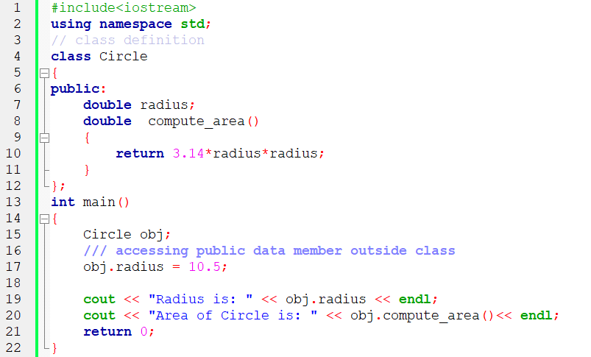
Access Modifier :: Public

Slide 5
Access Modifier :: Private
The class members declared as private can be accessed only by the functions inside the class.
They are not allowed to be accessed directly by any object or function outside the class.
Only the member functions or the friend functions are allowed to access the private data members of a class.

Slide 6
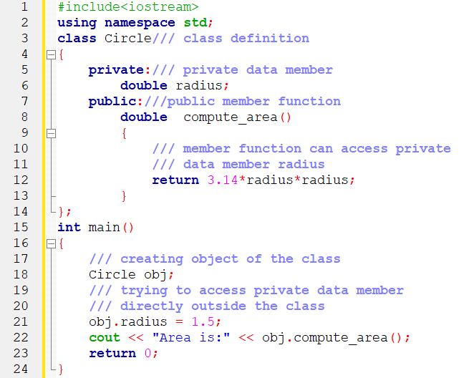
Access Modifier :: Private

Slide 7
Access Modifier :: Private
The output of the below program will be a compile time error because we are not allowed to access the private data members of a class directly outside the class.
However, we can access the private data members of a class indirectly using the public member functions of the class.

Slide 8
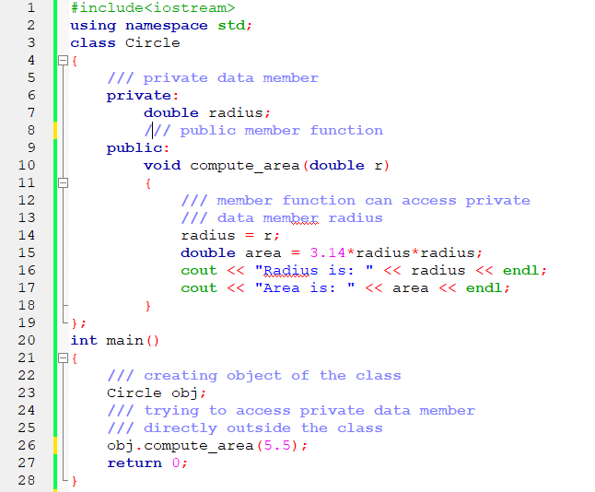
Access Modifier :: Private

Slide 9
Access Modifier :: Protected
Protected access modifier is similar to that of private access modifiers.
The difference is that the class member declared as Protected are inaccessible outside the class but they can be accessed by any subclass(derived class) of that class.

Slide 10
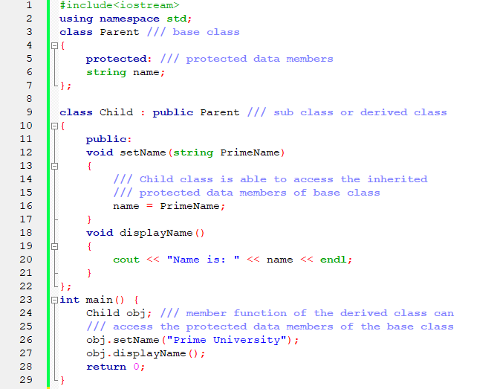
Access Modifier :: Protected

Slide 11
Access Modifier
public - members are accessible from outside the class
private - members cannot be accessed (or viewed) from outside the class
protected - members cannot be accessed from outside the class, however, they can be accessed in inherited classes.

Slide 12
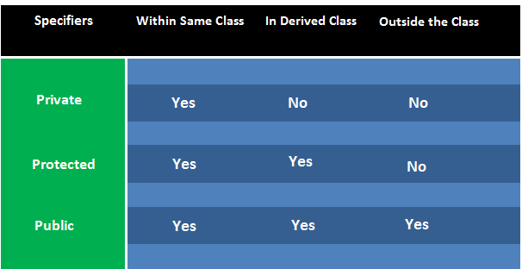
Access Modifier in a View

Slide 13
Thank You

